Slide 1
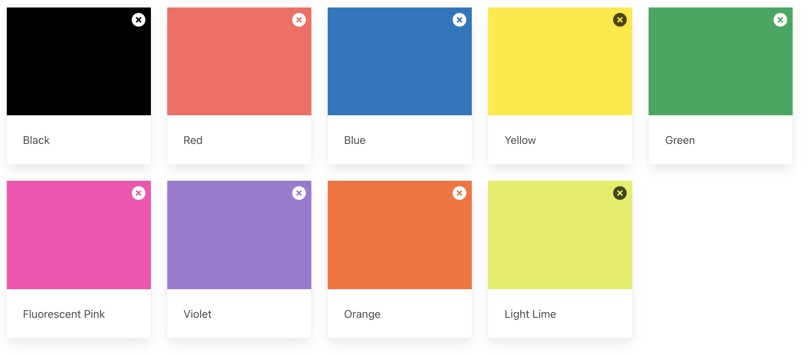
Ink color

Slide 2
Paper color
Inside paper (60 lb paper/text paper)
Cover paper (65 – 100 lb cardstock)
Neenah Astrobright
Springhill Opaque
Neenah Astrobright
Pop Tone cardstock

Slide 3
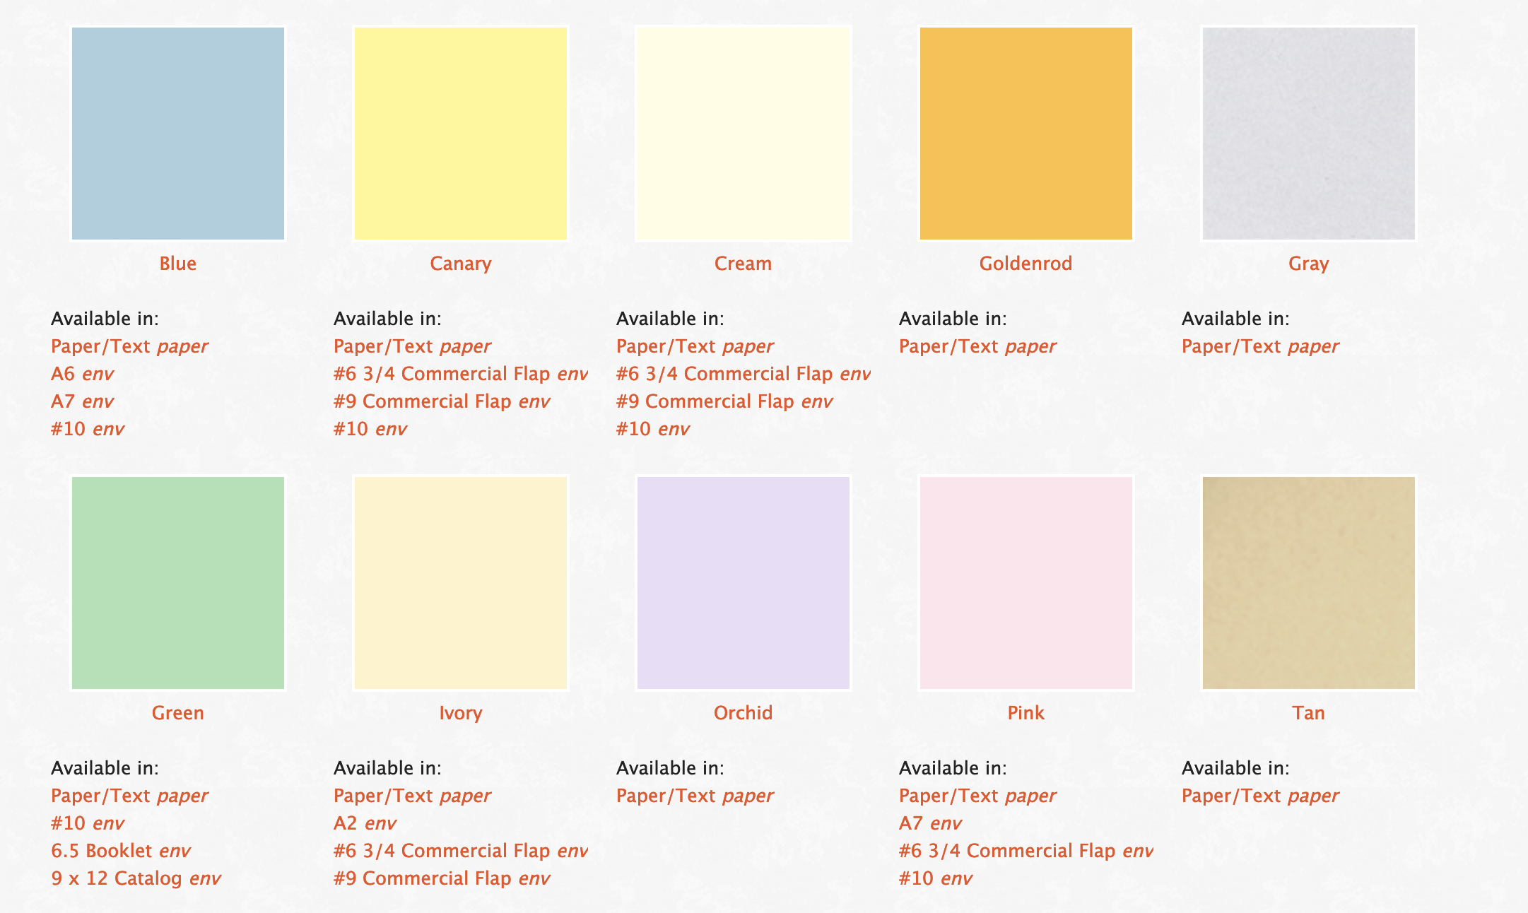

Slide 4
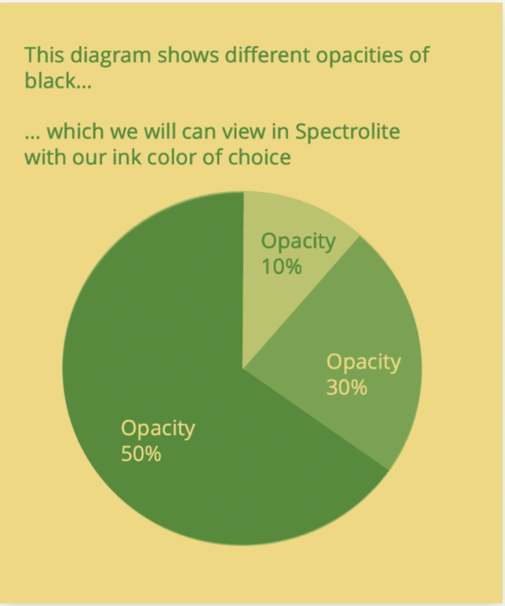
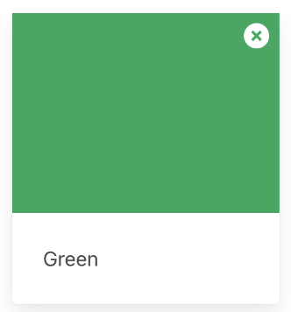
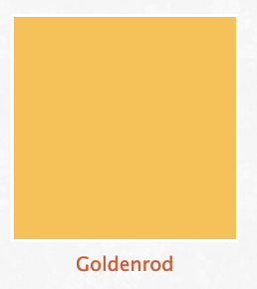
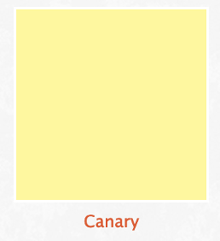
Ink
Paper
+

Slide 5
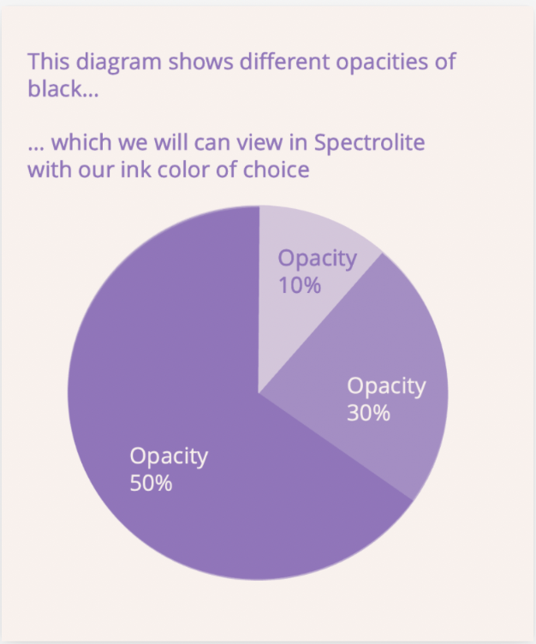
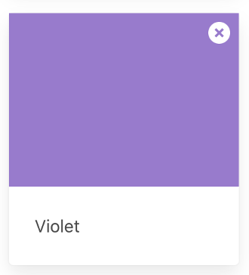
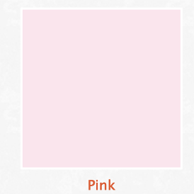
Ink
Paper
+

Slide 6
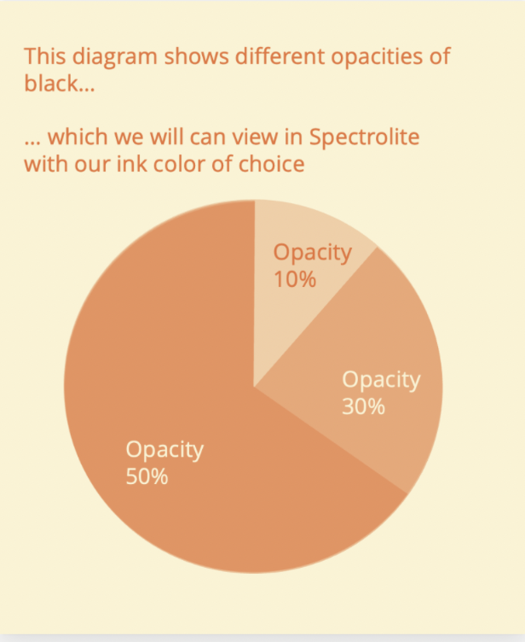
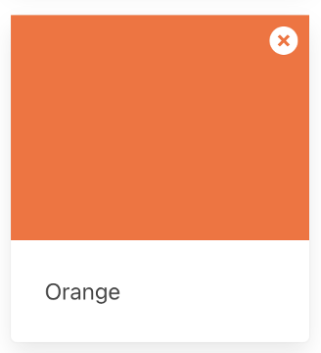
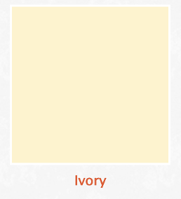
Ink
Paper
+

Slide 7
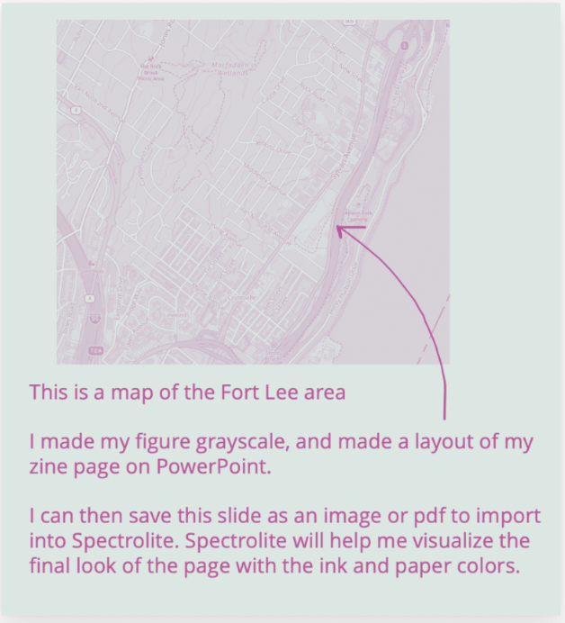
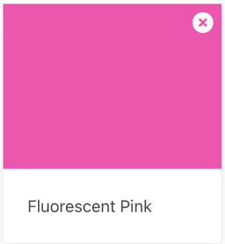
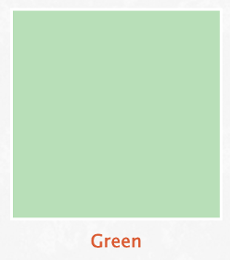
Ink
Paper
+

Slide 8
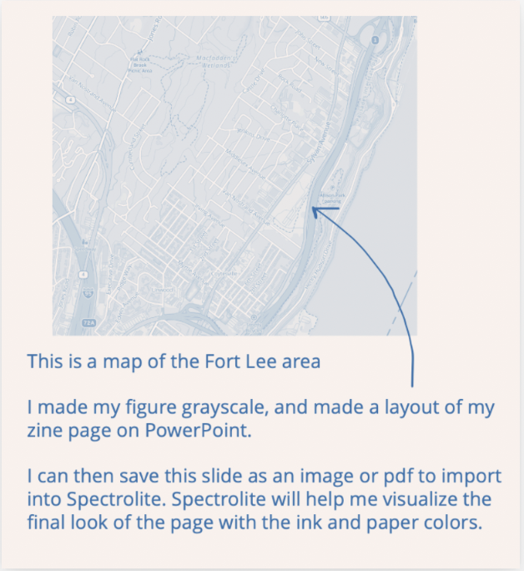
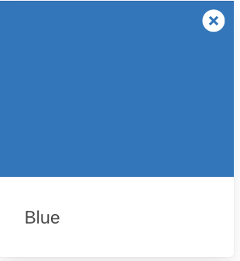
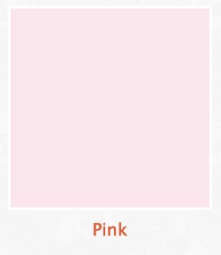
Ink
Paper
+

Slide 9
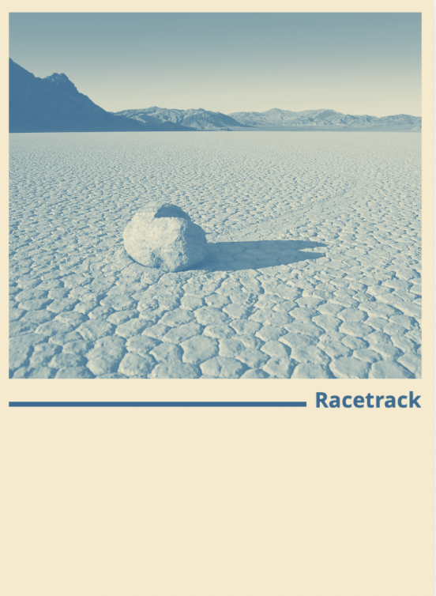
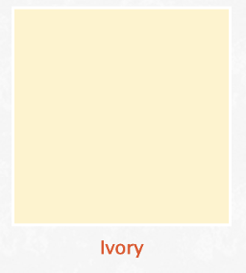
Ink
Paper
+

Slide 10
Number of pages
8
12
16
20

Slide 11
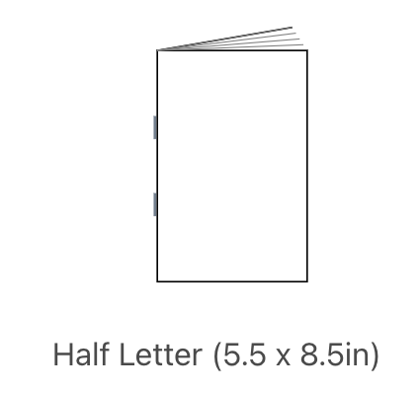
12
1
2
11
10
3
4
9
8
5
6
7

Slide 12
Goals for today
1. Decide on ink color, paper color, & number of pages
2. Draft (by hand or digital) of zine content & layout

Slide 13
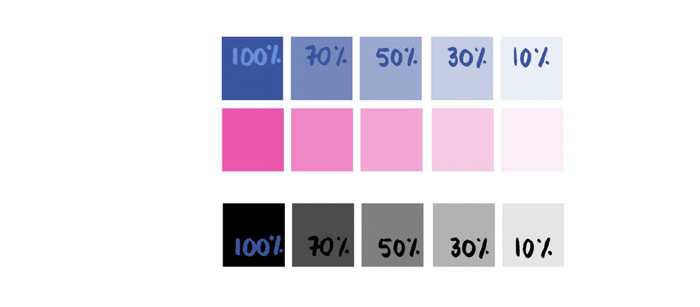
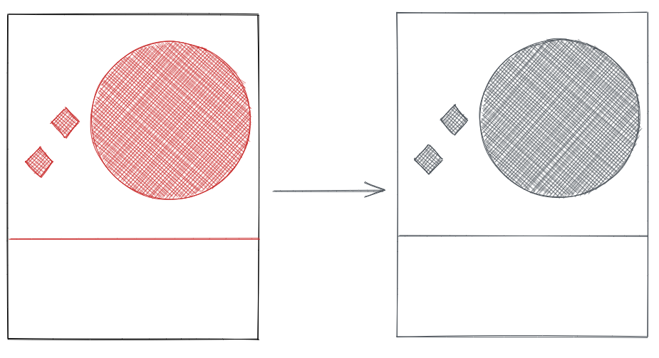
Color value
Illustrations from RisoPop

Slide 14
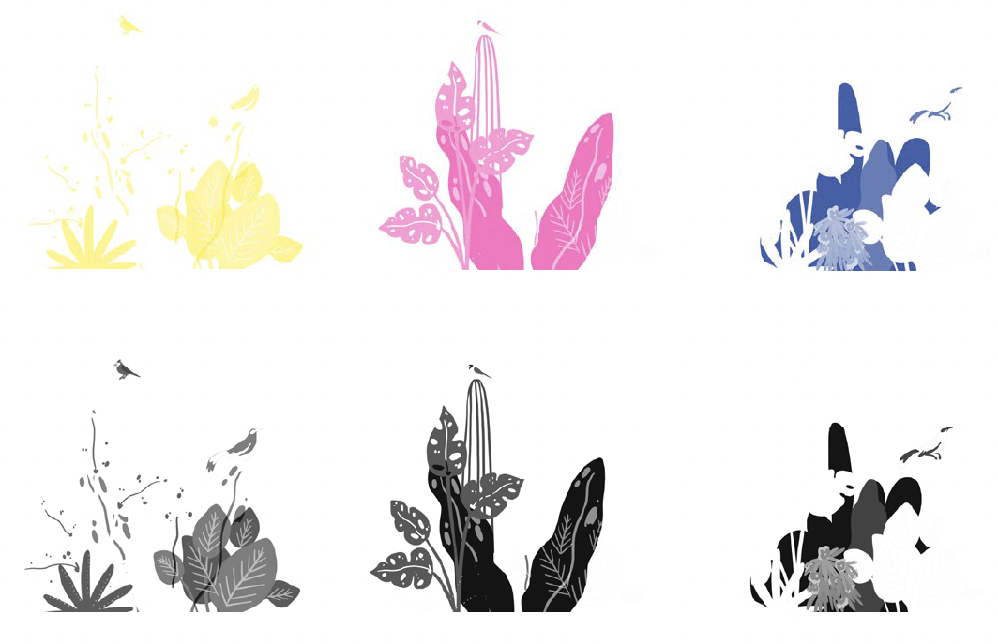
Color options & separation
Illustrations from RisoPop

Slide 15
Github
https://github.com/Elizabethcase/nycclimatezine
resources
templates
This presentation
Color profiles
example zines
a walkthrough of the process
A way to get in touch

